Slide 1
TPL Dataflow The best little async library you’ve never heard of…
From the docs:
The Task Parallel Library (TPL) provides dataflow components to help increase the robustness of concurrency-enabled applications.
What it actually does is give you the tools to create in-process async pipelines in a simple, structured manner.
And I'm betting that like me (until recently), this is a library you'll never even have heard of.
I'll cover the basics - Sources, Targets and Blocks - and how to link them together into useful **asynchronous** and **parallel** pipelines within your programs.
We'll handle error conditions, cancellation and how to control the degree of parallelism - with samples that give you a bit more than "Hello World".
W: https://www.hammond-turner.org.uk
E: joel@Hammond-turner.org.uk
T: @Rammesses

Slide 2

TPL Dataflow
The best little async library you’ve never heard of…
Joel Hammond-Turner
e: joel@hammond-turner.org.uk
t: @rammesses

Slide 3
What is the TPL Dataflow Library?
“The Task Parallel Library provides dataflow components to help increase the robustness of concurrency-enabled applications.”
“The Task Parallel Library provides dataflow components to help increase the robustness of concurrency-enabled applications.”
Notes:
Available since .NET 4.5
Never part of the base framework
Leverages the TPL

Slide 4
What is the TPL Dataflow Library?
TPL Dataflow promotes actor/agent-oriented designs through primitives for in-process message passing, dataflow, and pipelining. TDF builds upon the APIs and scheduling infrastructure provided by the Task Parallel Library (TPL), and integrates with the language support for asynchrony provided by C#, Visual Basic, and F#.
TPL Dataflow promotes actor/agent-oriented designs through primitives for in-process message passing, dataflow, and pipelining. TDF builds upon the APIs and scheduling infrastructure provided by the Task Parallel Library (TPL), and integrates with the language support for asynchrony provided by C#, Visual Basic, and F#.
Notes:
Actor pattern

Slide 5
What is the TPL Dataflow Library?
Actor/agent components for asynchronous dataflow / pipelines

Slide 6

If TPL Dataflow is the Solution… What’s my problem?
Notes:
Explain the progression of the samples

Slide 7
But, WHAT is the TPL Dataflow Library?

Slide 8
It’s all about the Blocks
ITargetBlock<T>
Input Buffer
IDataflowBlock
Activity
ISourceBlock<V>
Output Buffer
Notes:
Sources
Targets
Propagators
Connected together into pipelines
Filtering (of connections), Exception handling, Completion events, Cancellation.

Slide 9
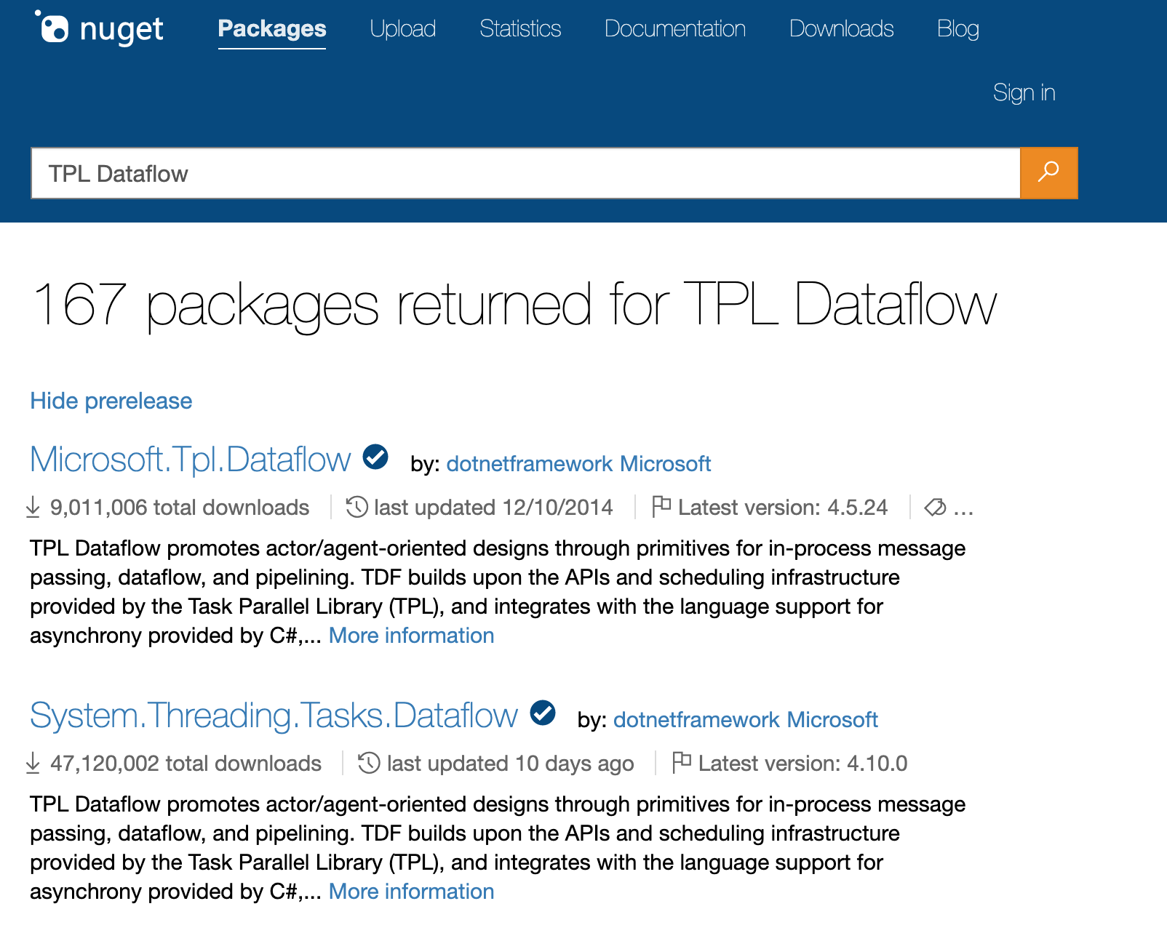
Getting the TPL Dataflow Library

Slide 10
Getting the TPL Dataflow Library
Add via NuGet
> dotnet add package System.Threading.Tasks.Dataflow
PM> install-package System.Threading.Tasks.Dataflow

Slide 11
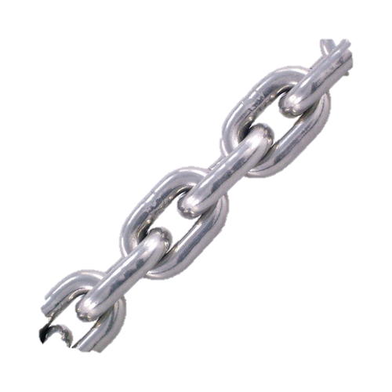
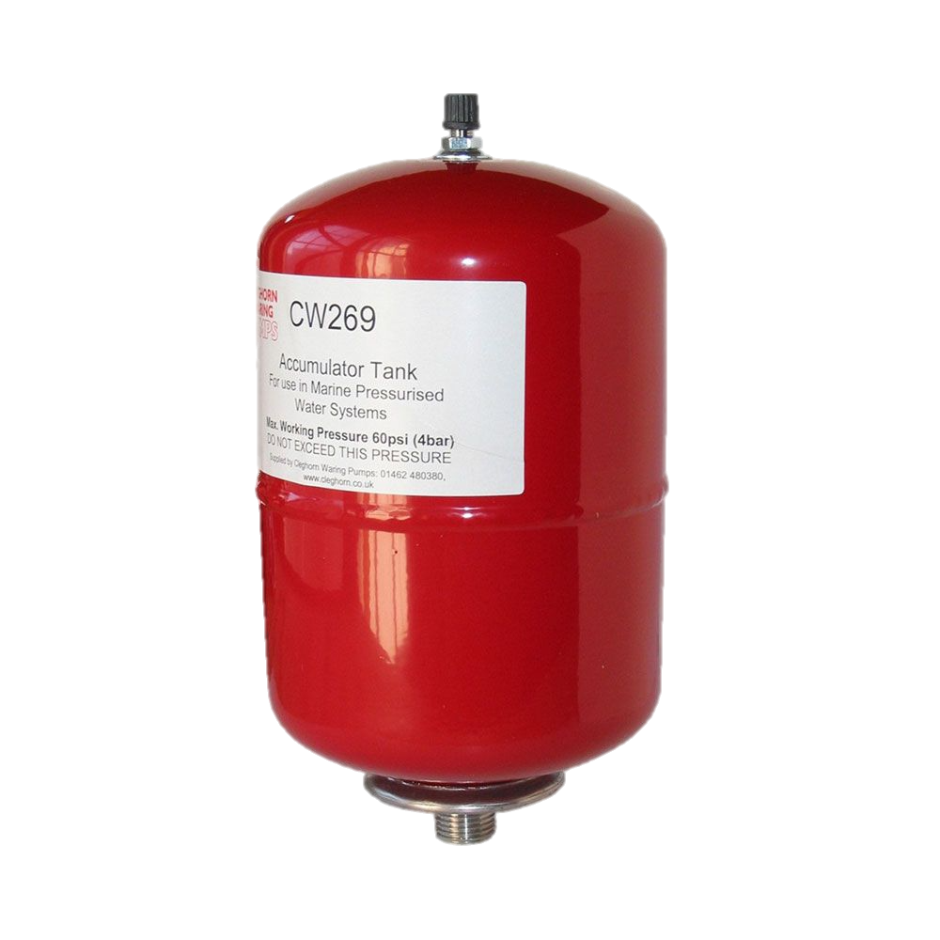
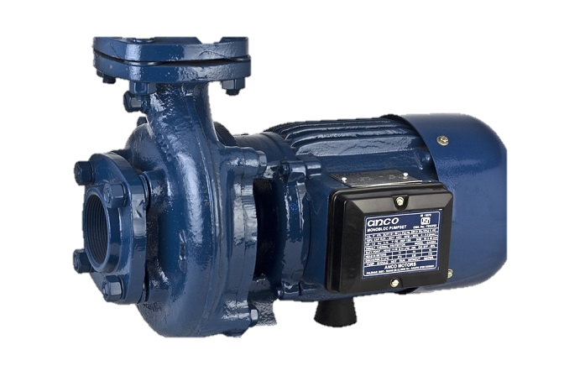

What’s in the box?
Linking
Framework
Buffering Blocks
BufferBlock
BroadcastBlock
WriteOnceBlock
Execution Blocks
ActionBlock
TransformBlock
TransformManyBlock
Grouping Blocks
BatchBlock
JoinBlock
BatchedJoinBlock

Slide 12
Buffering Blocks
Buffering blocks hold data for use by data consumers.
BufferBlock<T> - FIFO Queue
BroadcastBlock<T> - Capture & replay latest value posted
WriteOnceBlock<T> - Capture & replay a single constant value

Slide 13
Execution Blocks
Execution blocks call a user-provided delegate for each piece of received data.
ActionBlock<TInput> - Do work
TransformBlock<TInput,TOutput> - Do work on a thing & return another thing
TransformManyBlock<TInput,TOutput> - Do work on a thing & return zero or many other things

Slide 14
Grouping Blocks
Grouping blocks combine data from one or more sources and under various constraints.
BatchBlock<T> - Buffer input and output as batches
JoinBlock<T1,T2> - Merge 2 (or 3) streams and output a stream of tuples
BatchedJoinBlock<T1,T2> - Merge 2 (or 3) streams and output a stream of batches of tuples

Slide 15


My First TPL Dataflow
Generator
Buffer
Action
SHOW ME THE CODE!
Notes:
Build Demo project up to Sample-1 (using snippets)
Explain chaining
Show serialized execution
Show parallel execution

Slide 16
My First TPL Dataflow
Generator
Buffer
Action
Notes:
Build Demo project up to Sample-1 (using snippets)
Explain chaining
Show serialized execution
Show parallel execution

Slide 17
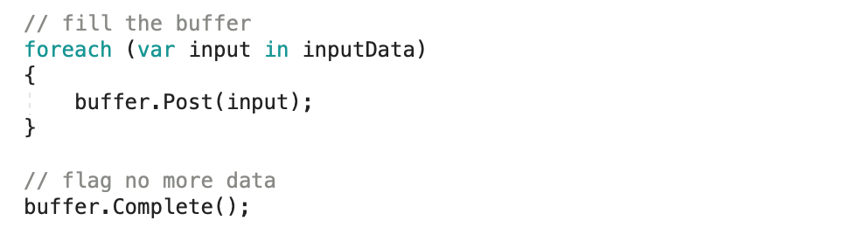
My First TPL Dataflow
Use Post / SendAsync to get data into a block
Don’t forget to call Complete!

Slide 18
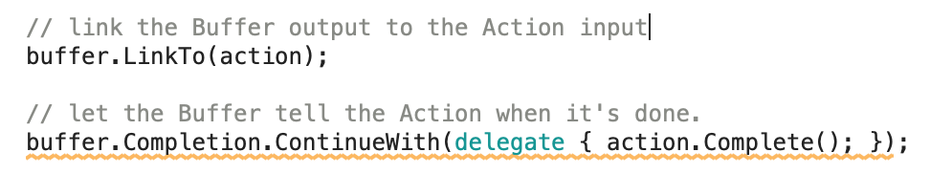
My First TPL Dataflow
Outputs Link to Inputs
Don’t forget to chain the Completion event!

Slide 19
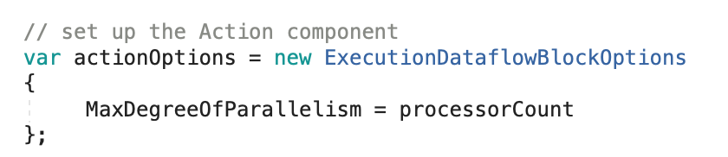
My First TPL Dataflow
Execution Blocks execute serially
Unless you specify parallelism!

Slide 20
What Else can you do with TPL Dataflow?

Slide 21
What ELSE can you do with TPL Dataflow
Write your own Blocks!
Inherit from the OOB Blocks
Implement IPropagatorBlock<T, V> or use DataBlock.Encapsulate
Implement IDataflowBlock
Implement ISourceBlock<T> / IReceivableSourceBlock<T>
Implement ITargetBlock<T>

Slide 22
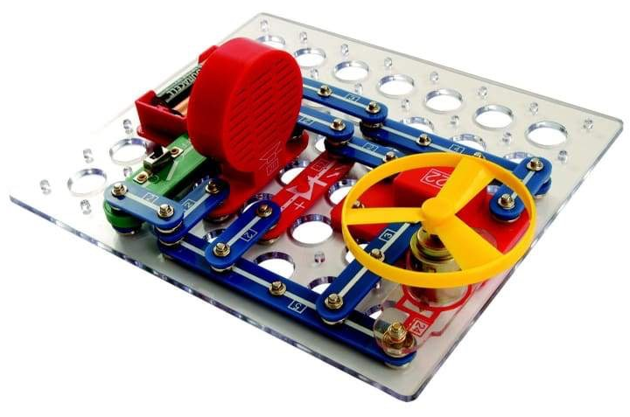
Something a bit more complex
Generator
Get Wikipedia Data (Transform Block)
Summarise (Custom Block)
Display (ActionBlock)
SHOW ME THE CODE!
Notes:
Show Sample-2
Walk through the custom block
Show how filtering can be used, but borks things…

Slide 23
Something a bit more complex
Generator
Get Wikipedia Data (Transform Block)
Summarise (Custom Block)
Display (ActionBlock)
Notes:
Show Sample-2
Walk through the custom block
Show how filtering can be used, but borks things…

Slide 24

Something a bit more complex
Writing custom blocks isn’t hard
Don’t forget to implement all the interfaces
Don’t forget to call / chain Complete() as required…

Slide 25

Split & Join - Doubles anyone?
Generator
Get Wikipedia Data (ActionBlock)
Make Pairs (JoinBlock)
SHOW ME THE CODE!
Output (ActionBlock)
Make Matches (BatchBlock)

Slide 26
Split & Join - Doubles anyone?
Generator
Get Wikipedia Data (ActionBlock)
Make Pairs (JoinBlock)
Output (ActionBlock)
Make Matches (BatchBlock)

Slide 27
TPL Dataflow Library is Async Plumbing

Slide 28
TPL Dataflow Library is Async Plumbing
Linking
Framework
Buffering Blocks
BufferBlock
BroadcastBlock
WriteOnceBlock
Execution Blocks
ActionBlock
TransformBlock
TransformManyBlock
Grouping Blocks
BatchBlock
JoinBlock
BatchedJoinBlock

Slide 29
In Summary
Actor / agent components for asynchronous dataflow / pipelines
Hard to get your head around…
But not hard to use
Flexible
IN MEMORY!
For persistent flows use Azure ServiceBus & Stateful Functions!

Slide 30
TPL Dataflow
The best little async library you’ve never heard of…
Repo: https://bit.ly/TPLDataflow-Repo
Deck: https://bit.ly/TPLDataflow-Deck
Feedback: http://bit.ly/TPLDataflow-Feedback
Joel Hammond-Turner
e: joel@hammond-turner.org.uk
t: @rammesses

